Slide 1
Big Data and Data Engineering Basics: Data Intensive Programming Models
Damian A. Tamburri, Ph.D.

Slide 2
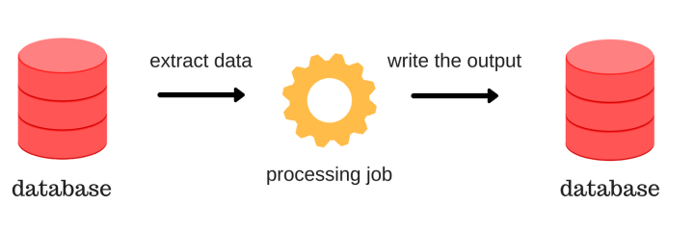
Batch Processing
Batch processing is executing a series of programs ("jobs") on a computer without manual intervention.
Batch processing has many benefits:
It can shift the time of job processing to when the computing resources are less busy.
It reduces manual intervention and supervision.
By keeping an overall high rate of utilization, it amortizes the costs.
It allows the system to use different priorities for batch and interactive work.

Slide 3
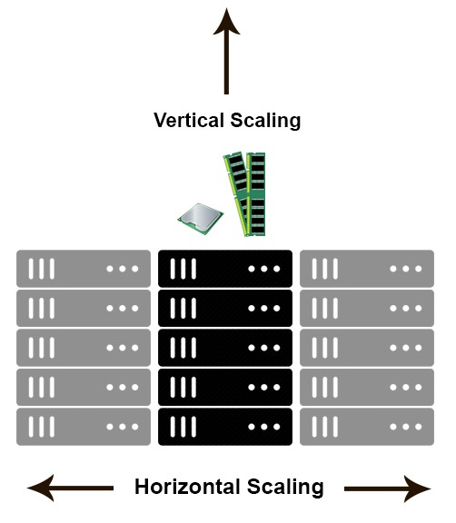
Batch Processing of Large Data Sets
Large datasets entail vast amounts of data (multi-terabyte datasets) in parallel on large clusters (thousands of nodes) of commodity hardware. Thus, horizontal scaling is required.
Some Examples.
Bioinformatics data from about 3.3 billion base pairs in the human genome to vast protein sequences.
The internet; e.g., Facebook, Twitter, weblogs, maps.
Financial applications to grasp financial trends.
Astronomy; e.g., the Hubble ultra-deep telescope shows hundreds of galaxies, each with billions of stars.
Health Care with massive amounts of patient, drug, and treatment data.

Slide 4
Classical Data Mining
Reading a word from disk versus main memory is 10⁵ slower!
Although reading many contiguously stored words is faster, modern disks still only reach 150 MB/s for sequential reads.
Therefore, there is an I/O bound in Data Mining!
The biggest performance bottleneck is reading from/writing to disk.
100 GBs ~10 minutes to read
200 TBs ~200 minutes to read ~13 days
CPU
Memory
Disk

Slide 5
Classical Data Mining
Classical data mining (e.g., Apache Lucene) focuses on efficient disk usage.
The I/O bound is a significant limitation when processing large files.
CPU
Memory
Disk
How to solve this issue?

Slide 6
Distributed Architecture (Cluster)
Switch
Rack 1
Rack 2
Switch
Switch
…
CPU
CPU
CPU
CPU
CPU
CPU
Memory
Memory
…
Memory
Memory
Memory
…
Memory
Although our model considers a machine a CPU/disk pair, modern setups often have multiple CPUs and disks per server.
Disk
Disk
Disk
Disk
Disk
Disk

Slide 7
Challenges for Cluster Computing
Nodes fail: 1 in 1,000 nodes fails everyday.
Network is a bottleneck: typically 1-10 Gb/s throughput.
Traditional distributed programming is often ad-hoc.
Duplicate data
Bring computation to nodes, rather than data to nodes
We should aim for programs that can be easily distributed
These limitations are addressed by MapReduce/Hadoop/Spark!

Slide 8
What is MapReduce?
Map-Reduce is a programming model.
Input chunks => map tasks | group_by keys | reduce tasks => output
| is the Linux pipe symbol: the output of a process is used as input of the next one.
e.g., Word Counter
“tokenize(document) | sort | uniq –c”
2. A system that distributes MapReduce-style programs across a distributed file system. e.g., Apache Hadoop with HDFS or Apache Spark

Slide 9
MapReduce Programming Model
Step 1: Map
Read input and produces a set of key-value pairs
Step 2: Sort / Group by
Collect all pairs with same key
(Hash merge, Shuffle, Sort, Partition)
Step 3: Reduce
Collect all values belonging to the key and output
Intermediate key-value pairs
Key-value groups
k
v
reduce
Input key-value pairs
k
v
v
v
k
v
map
k
v
k
v
reduce
k
v
v
k
v
Group by key
k
v
map
k
v
…
…
…
…
k
v
k
v
k
v
k
v
J. Leskovec, A. Rajaraman, J. Ullman: Mining of Massive Datasets, http://www.mmds.org

Slide 10
MapReduce from the Programmer Perspective
Given a set of key-value pairs, you must specify two methods.
  Map(k, v) → <k’, v’>* takes a key-value pair and outputs a set of key-value pairs;
  e.g., the key is the filename, and the value is a single line in the file.
    A Map call is executed for each (k,v) pair.
  Reduce(k’, <v’>*) → <k’, v’’>* reduces together all values v’ with same key k’ in v’ order.
    A Reduce call is executed for each unique key k’.
J. Leskovec, A. Rajaraman, J. Ullman: Mining of Massive Datasets, http://www.mmds.org

Slide 11
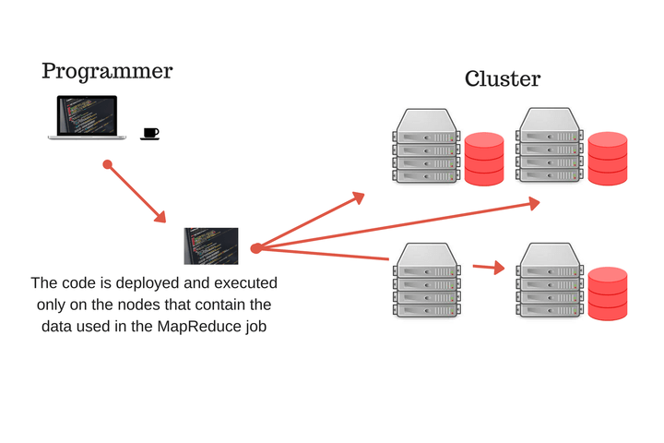
MapReduce from the Programmer Perspective
You provide the Map and Reduce functions and the input files.
The program workflow:
  Read and prepare the input as a set of key-value pairs.
  Run the Map code on the kv pairs to generate a new set of k'v’ pairs.
  Shuffle the k'v’ pairs to the reduce functions.
  Reduce all k'v'-pairs grouped by key into new k'v''-pairs.
  Produce the final output.
All phases are distributed with many tasks doing the work.

Slide 12
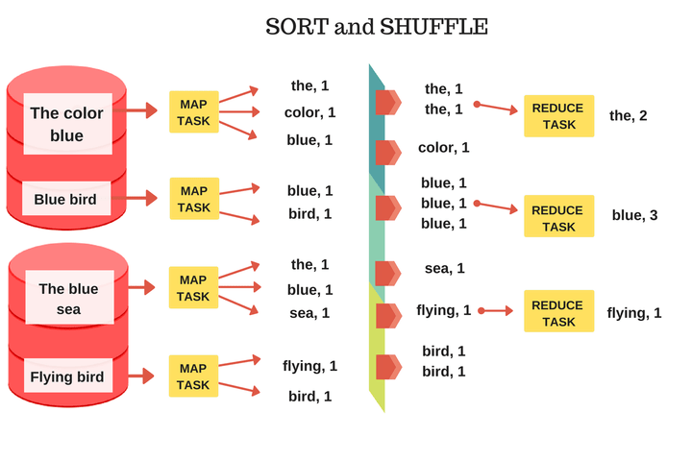
MapReduce for Word Counting
map(String key, String value):
// key: document name
// value: document contents
for each word w in value: EmitIntermediate(w, “1”);
reduce(String key, Iterator values):
// key: a word
// values: a list of counts
int result = 0;
for each v in values: result += ParseInt(v);
Emit(AsString(result));

Slide 13
Challenges for Cluster Computing
Nodes fail: 1 in 1,000 nodes fails everyday.
Network is a bottleneck: typically 1-10 Gb/s throughput.
Traditional distributed programming is often ad-hoc.
Duplicate data
Bring computation to nodes, rather than data to nodes
We should aim for programs that can be easily distributed
Simply define the map and reduce functions
These limitations are addressed by MapReduce!
We need a distributed filesystem to resolve the other two issues.

Slide 14
Distributed Filesystems
Let us consider two different files (i.e., C and D) and four servers.
C₀
C₂
D₂
D₀
C₄
C₂
C₀
C₁
D₂
C₃
D₁
C₃
D₁
C₁
D₀
C₄
Data Node 1
Data Node 2
Data Node 3
Data Node 4
Apache Hadoop and Spark rely on Hadoop Distributed File System (HDFS).

Slide 15
Distributed Filesystems: Components
Data Nodes => workers
In data nodes, each file is split into contiguous chunks.
Typically, each chunk is 16 - 64 MB.
Each chunk is replicated to avoid data losses.
Try to keep data replicas in different racks.
Name Node => master/primary node
Takes care of the coordination; e.g., it knows where the files are stored.
Client library for file access
Communicates to the master node to find chunk servers.
Connects directly to chunk servers to access data.
J. Leskovec, A. Rajaraman, J. Ullman: Mining of Massive Datasets, http://www.mmds.org

Slide 16
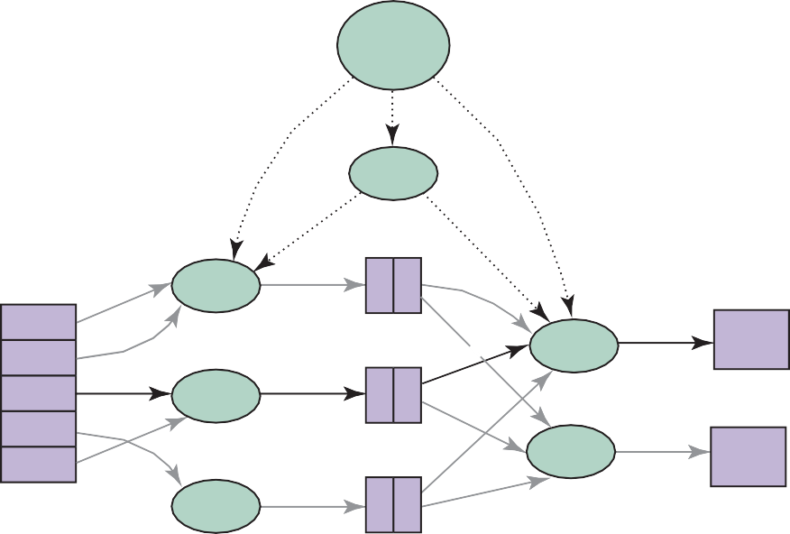
MapReduce Environment: Apache Hadoop
Apache Hadoop and Spark distributes MapReduce model programs across a distributed file system.
User Program
(1) fork
(1) fork
(1) fork
Master
(2)
assign map
(2)
assign reduce
worker
split 0
(5) remote read
(6) write
output file 0
split 1
split 2
split 3
split 4
worker
(3) read
(4) local write
worker
worker
output file 1
worker
Input files
Map phase
Intermediate files (on local disks)
Reduce phase
Output files

Slide 17
Data Flow
Input and final output are stored on a distributed file system (FS):
the scheduler tries to put the map tasks “close” to the physical storage location of the input data.
Intermediate results are stored in the local FS of the Map and Reduce workers.
The output is often input to another MapReduce task.
Apache Hadoop and Spark handles
partitioning;
scheduling of the map and reduce function executions;
group by key;
restart from node failures;
inter-machine communication.

Slide 18
Master Node Tasks
A task can have three statuses: idle, in progress, completed.
The master node takes care of the coordination.
  Idle tasks get scheduled as workers become available.
  When a map task is completed, its node returns the location and size of the intermediate files to the master. The master node pushes this info to reducers.
Master node pings workers periodically to detect failures.

Slide 19
Dealing with Failures
Map worker failure
  Tasks completed or in progress by the map worker are reset to idle (i.e., they need to be scheduled).
  Reduce workers are notified when a task is rescheduled on another worker.
Reduce worker failure
  Only tasks in progress by the reduce worker are reset to idle (i.e., they need to be scheduled).
Master failure
  MapReduce task is aborted, and the client is notified.
Map tasks are scheduled near the physical storage of chunks to improve performance.
Intermediate results are stored locally.
Finally, the number of reducers should be higher than the number of nodes.

Slide 20
How many Map and Reduce jobs are needed?
M map tasks, R reduce tasks.
Rule of a thumb:
  Make M much larger than the number of nodes in the cluster.
  One chunk of the distributed FS per map is common.
  Use dynamic load balancing to speed up recovery from worker failures.
Usually, R is smaller than M
  Because the output is spread across R files.

Slide 21
Challenges for Cluster Computing
Nodes fail: 1 in 1,000 nodes fails everyday.
Network is a bottleneck: typically 1-10 Gb/s throughput.
Traditional distributed programming is often ad-hoc.
Duplicate data (HDFS)
Bring computation to nodes, rather than data to nodes (Sort and Shuffle)
Simply define the map and reduce functions

Slide 22
Beyond MapReduce: Backup Tasks
Problem
  Slow workers significantly increase the job completion time:
Solution
  Near the end phase, spawn backup copies of tasks: whichever one finishes first “wins”.
Effect
  Dramatically shortens job completion time.

Slide 23
Beyond MapReduce: Combiner Function
Often a Map task will produce many pairs of the form (k,v₁), (k,v₂), … for the same key.
e.g., popular words in the word count example
We can save network time by adding an extra layer and pre-aggregating values in the mapper:
  combine(k, list(v₁)) → v₂
  combine is usually hosted in the same node of the reduce function.
Combiners work only if the reduce function is commutative and associative.

Slide 24
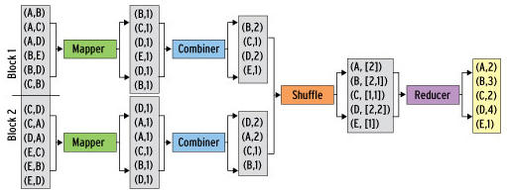
Beyond MapReduce: Combiner Function
Back to our word counting example:
  Combiner mix the values of all keys of a single mapper (i.e., a single machine):
  Much less data needs to be copied and shuffled!

Slide 25
Beyond MapReduce: Partition Function
  Continuous splits of the input are assigned to the same worker.
  The reduce function should ensure that records with the same intermediate key end up in the same worker.
MapReduce uses a default partition function: hash(key) mod R.
Sometimes it is helpful to override the hash function:
  hash(hostname(URL)) mod R ensures URLs from a host end up in the same output file.

Slide 26
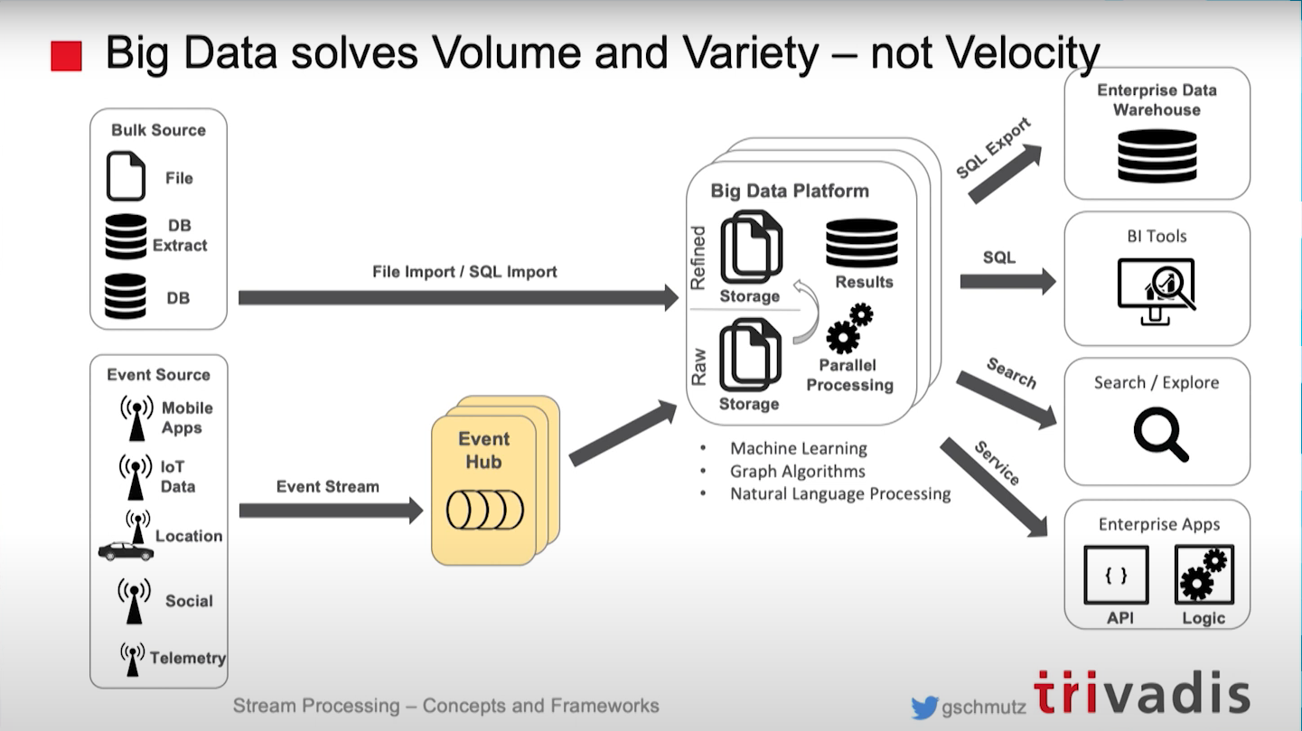
Batch Data Processing is Slow and not in RealTime
https://youtu.be/vFshGQ2ndeg

Slide 27
Stream Data Processing
Often, we do not know when data will be available. In such cases:
We cannot store them.
We cannot access them repeatedly.
We do not know how fast they will arrive.
Even insert them in a database does not make sense.
In sum, we cannot fit them in a disk, but we would like to analyze them to make some decisions.
Process

Slide 28
Stream Data Processing
The main differences compared to database management and batch processing are:
The input is not controlled by the system.
The input timing/rate is often unknown but controlled by users.
Process
Record in
Record out
The process could hold sliding windows of records (i.e., micro-batch) instead of single records.
…, #i, #g, #h, #a, #c, #b, #e, #d, #f, …
Examples:
Click streams
Twitter data
Sensor networks
Internet of Things
Monitoring data e.g., traffic, environment, networks
Standing Queries:
Stored and permanently executed
Ad-Hoc Queries:
One-time questions that need stored stream summaries

Slide 29
Stream Data Processing Use Cases
Monitoring and alerting: notification on events / patterns
Real-time reporting: aggregate statistics for dashboards
Real-time ETL (i.e., Extract, Transform, Load) and event-driven data updates
Real-time decision making: fraud detection
Data stream mining: summary statics with limited memory

Slide 30
General Stream Processing Model
Ad-Hoc Queries
Processor
Standing Queries
…, #i, #g, #h, #a, #c, #b, #e, #d, #f, …
Generalization/Summarization
A stream of records, often referred to as “elements” or ”tuples”.
In theory, it could be everything! (e.g., strings, number, bits, image files).
Streaming models exhibit real-time latency requirements:
Real-Time: guaranteed task completion by a given deadline (few ms)
Near Real-Time: few milliseconds to seconds
In practice, even longer latency could be accepted

Slide 31
Filtering
Select elements which adhere to a certain property.
e.g., if the size of a mail is smaller than 40B, consider it safe for the spam filter.
Solution: the Bloom Filter (approximate solution; allows false positives but not false negatives)

Slide 32
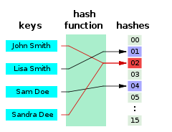
Back to Hash Functions
A hash function is any function that can be used to map data of arbitrary size to fixed-size values.
The values returned by a hash function are called hash values, hash codes, digests, or only hashes. The values are used to index a fixed-size table called a hash table.
The above example maps the keys to hashes.
As you can see “John Smith” and “Sandra Dee” are both mapped to “02”: this is a collision.

Slide 33
Bloom Filter
Given:
|S| keys to filter and mapped to |B| bits
hashes = h₁,h₂,…,h_{k} independent hash functions
Algorithm:
set all B to 0 #B is a bit vector
for each i in hashes, for each s in S:
set B[h_{i}(s)] = 1 #all bits resulting from
when a new element x arrives in the stream #filter
if B[h_{i}(s)] = 1 for all hash functions h_{i}:
consider x as belonging to S
else consider x as not belonging to S
Adding an element
Querying for an element
If any element in B is 0, the element is not in the set.
If all elements in B are 1:
the element is in the set;
the bits have by chance been set to 1 during the insertion of other elements (i.e., false positive).
In a simple Bloom filter, there is no way to distinguish between true and false positives.
As shown in the previous slide.

Slide 34

Bloom Filter: what is the probability of a false positive?
Question. What fraction of |B| are 1s?
Analogy. Throw |S|*k darts at n targets.
1 dart: 1/n
d darts: (1-1/n)^{d} = probability of 0 = e^{-d/n} are 0s.
= e⁻¹ for large n
Thus, (1-e^{-d/n}) are 1s.
Probability of all k being 1?
(1-e^{-(|S|*k)/n})^{k}
We can expand S if |B| has room

Slide 35
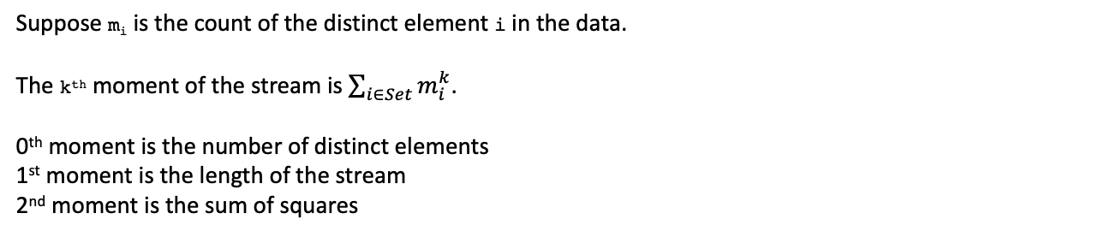
Counting Moments
Many practical applications.
Counting…
Number of words in a document
Distinct websites
Users who visit a website
Unique hashtags in Twitter
Suppose m_{i} is the count of the distinct element i in the data.
The k^{th} moment of the stream is $\sum_{i∈Set}{m_{i}^{k}}$.
0th moment is the number of distinct elements
1st moment is the length of the stream
2nd moment is the sum of squares
This is trivial as we just need to increment a counter.

Slide 36
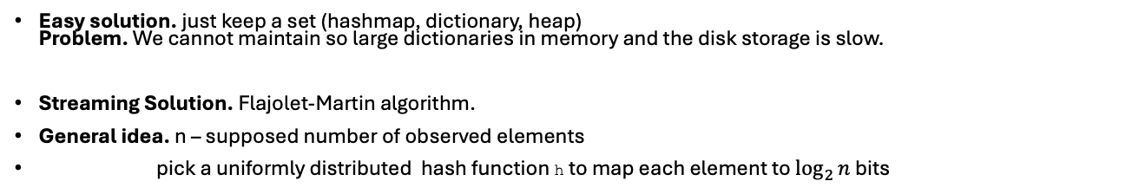
0th Moment
Easy solution. just keep a set (hashmap, dictionary, heap)
Problem. We cannot maintain so large dictionaries in memory and the disk storage is slow.
Streaming Solution. Flajolet-Martin algorithm.
General idea. n – supposed number of observed elements
pick a uniformly distributed hash function h to map each element to $\log_{2}{n}$ bits
Let us define bit(y,k) as a function that returns the k^{th} bit in the binary representation of y.
Let us define p(y) as a function that returns the position of the least-significant set bit of the binary representation of y.

Slide 37
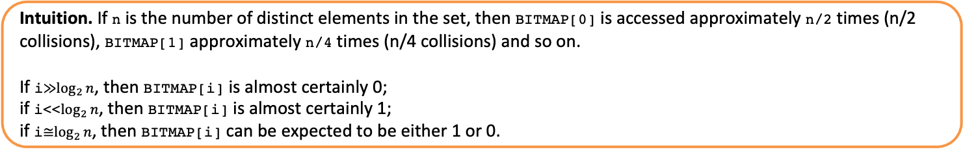
Flajolet-Martin algorithm.
Let us define bit(y,k) as a function that returns the k^{th} bit in the binary representation of y.
Let us define p(y) as a function that returns the position of the least-significant set bit of the binary representation of y.
Initialize a bit-vector BITMAP to be of length L and contain all 0s.
For each element x in the set:
Calculate the index i = p(hash(x))
Set BITMAP[i] = 1
Set R to the smallest index i such that BITMAP[i]=0
Estimate the cardinality of the set as 2^{R}
Intuition. If n is the number of distinct elements in the set, then BITMAP[0] is accessed approximately n/2 times (n/2 collisions), BITMAP[1] approximately n/4 times (n/4 collisions) and so on.
If i≫$\log_{2}{n}$, then BITMAP[i] is almost certainly 0;
if i<<$\log_{2}{n}$, then BITMAP[i] is almost certainly 1;
if i≅$\log_{2}{n}$, then BITMAP[i] can be expected to be either 1 or 0.

Slide 38
Counting Moments
Many practical applications.
Counting…
Number of words in a document
Distinct websites
Users who visit a website.
Unique hashtags in Twitter
Suppose m_{i} is the count of the distinct element i in the data.
The k^{th} moment of the stream is $\sum_{i∈Set}{m_{i}^{k}}$.
0th moment is the number of distinct elements
1st moment is the length of the stream
2nd moment is the sum of squares
This is trivial as we just need to increment a counter.
A solution based on streaming algorithms is available also for the 2nd moment. You can find more info on the “Mining of Massive Datasets” book (http://mmds.org/)

Slide 39
Architecture - Native Streaming
Data streaming
Asynchronous operations
Data dependencies
Memory
Data archive
Operator model
Read from input queue
Write to potentially many output queues
Sample instances

Slide 40
Architecture - Sharing
Multi-Query Optimization
Given a set of continuous deployed queries, common subexpression elimination is applied to optimize code.
e.g., let us assume to have to expressions
a = b * c + g;
d = b * c * e;
the code will be transformed in
tmp = b * c;
a = tmp + g;
d = tmp * e;
Operator and Queue Sharing
Operator sharing to manage complex operations.
Queue sharing to avoid duplication in output queues.

Slide 41
Architecture – Handling Overload
Data streaming
Asynchronous operations
Data dependencies
Memory
3 ms
Data archive
20 ms
#1 Back Pressure
Slow down sources to avoid data loss (e.g., blocking queues).
#2 Load Shedding
#1 Random-sampling-based load shedding
#2 Relevance-based load shedding
#3 Summary-based load shedding
Given a SLA, select the queries and shedding that minimize the error and satisfy the constraints.
#3 Distributed Stream Processing
Data flow partitioning: distributed the query
Key range partitioning: distribute the data stream

Slide 42
Random Sampling
Let us create a random sample for statistical analysis.
Process
Should we keep this element?
yes
Limited Memory
Sometime in the future
Run a process to answer queries

Slide 43
Random Sampling
Let us create a random sample for statistical analysis.
Simple Solution: generate a random number for each arriving record.
record = stream.next()
if random() <= 0.05: keep --- true 5% of times
memory.write(record)
random() <= 0.05
Limited Memory
yes

Slide 44
Random Sampling
Let us create a random sample for statistical analysis.
Simple Solution: generate a random number for each arriving record.
record = stream.next()
if random() <= perc: keep #true perc of times
memory.write(record)
Problem: records often are not the units of the statistical analysis.
e.g., a general tweet is not the unit of analysis to find the trending hashtags of a specific user.
Solution: hash into N=1/perc buckets; designate one bucket as “keep”.
if hash(tweet[’user_id’]) == 1: keep
Although we need to store only the hash functions to answer our query, the remaining data could be useful to answer standing queries.

Slide 45
Event, Ingestion, and Processing Time
Event Time: real time when the event/data item was created.
Ingestion Time: system time when the data item was received.
Processing Time: system time when the data item is processed.
In a real-world scenario, the processing time is delayed, and data/order can be processed unordered.
Therefore, heuristics (e.g., watermarks) or more complex triggers (providing results later) are used.

Slide 46
Durability and Consistency Guarantees
#1 At Most Once
”Send and forget”, ensure data is never counted twice
Might cause data loss on failures
#2 At Least Once
”Store and forward”, acknowledgements from receiver i.e., replay a stream from a checkpoint on failures
Might create incorrect state because data is processed multiple times
#3 Exactly Once
“Store and forward” with guarantees regarding state updates and sent messages
Often via dedicated transaction mechanisms

Slide 47
Window Semantics
Some operations (e.g., joins) can be computed over windows of time or elements to avoid them being undefined over unbounded streams.
#1 Tumbling Window
Every data item is part of only one window.
Using tumbling windows, a join is computed as usual.
#2 Sliding Window
Time- or tuple-based sliding windows.
New data is inserted and old data expires.

Slide 48
Large-scale Stream Processing
Stream groups can be created to achieve data parallelism.
#1 Shuffle Grouping
Tuples are randomly distributed across workers.
Good load balance.
#2 Field Grouping
Tuples are partitioned by grouping attributes.
Guarantees order within keys, but the load is not balanced if skewed.

Slide 49
Discretized Stream (Batch) Computation
Combined with distributed batch analytics, discretized stream computation enable fault tolerance.
The input tuples are batched based on the ingestion time.
Stateless, deterministic tasks are run periodically as distributed jobs.
All tasks return RDDs (i.e., sequences of immutable partitioned datasets)
Batch computation
Limitations: higher latency than usual.
Apache Spark is based on micro-batch computation with exactly once guarantee.
This characteristic is provided by back-pressure and watermarks.
Since version 2.3 continuous streaming is also supported.

Slide 50
Some Stream Data Processing Use Cases
Telecom call data
  Data: streams of call records
  Queries: fraud detection, customer call patterns, billing
Financial applications
  Data: streams of trading data, stock tickers, news feeds
  Queries: arbitrage opportunities, analytics, patterns
Web tracking and personalization
  Data: Clickstreams, user query streams, log records
  Queries: monitoring, analysis, personalization
Social media applications
  Twitter Trends
Monitoring and alerting: notification on events/patterns
Real-time reporting: aggregate statistics for dashboards
Notes:
Arbitrage is the simultaneous purchase and sale of an asset in different markets to exploit tiny differences in their prices. Arbitrage trades are made in stocks, commodities, and currencies. Arbitrage takes advantage of the inevitable inefficiencies in markets.

Slide 51
Batch Processing vs Stream Processing
Dataset size
  Known and finite
Processing time
  Longer (including days/weeks)
Data input rate
  Static or can be controlled by the data processor.
Data scope
  Process all or most of the data in the dataset
Data analysis scope
  Complex analysis (almost any complex query)
Data (response) output rate
  A response is provided after a job completion.
  Controlled via scheduling
Dataset size
  Unknown and infinite
Processing time
  Often milliseconds (sub-seconds)
Data input rate
  Dynamic and cannot be (mostly) controlled by the processor
Data scope
  Process the most recent data records, or a sample/summary, or the data in a sliding time window (small)
Analysis scope
  Relatively simple analysis (e.g., average over a time window)
Data (response) output rate
  As fast as the data input rate
  Continuous immediate responses
Batch Processing
Stream Processing
Notes:
data stream: real-time, continuous, ordered (implicitly by arrival time or explicitly by timestamp) sequence of items, too large to store entirely, not ending
Batch processing has the advantage of being able to perform deep analysis, including machine learning, and the disadvantage of having high latency. Stream processing has the advantage of low latency, and the disadvantage of only being able to perform simple analysis, such as calculating average values over a time window and flagging deviations from the expected values.
Hybrid processing combines both methods and reaps the benefits of both. In general, the data is processed as a stream and simultaneously branched off to storage for later batch processing. To give an example, consider an acoustic monitor attached to an industrial machine. The stream processor can detect an abnormal squeak and issue an alert; the batch processor can invoke a model to predict the time to failure based on the squeak as it progresses, and schedule maintenance for the machine long before it fails.
By analyzing stream data in real time, you can detect unusual events, significant deviations from normal values, and developing trends. That can then inform real-time responses, such as turning on the irrigation when a field is drying out, or buying a stock when its trades have dipped below a target value

Slide 52
DBMS vs Stream Data Management System (SDMS)
Type of Data
  Persistent relations
  (relatively static, stored)
Processing Model
  Query-Driven (Pull Model)
Type of Query
  One-time queries /ad-hoc
Data Access
  Random data access
Storage Capacity
  Unbounded Secondary Disk Storage
Rate of Data Change
  Relatively low update rate
Type of Data
  Transient streams
  (on-line analysis)
Processing Model
  Data-Driven (Push Model)
Type of Query
  Continuous/Standing queries
Data Access
  Sequential data access
Storage Capacity
  Bounded Main Memory
Rate of Data Change
  High/continuous updates
DBMS
SDMS
A relation (in databases) is a data structure that consists of a heading and an unordered set of tuples that share the same type.
Notes:
A "relation" is a table, the heading being the definition of the structure and the rows being the data.
Other answers give strict definitions of what can be called a "relation". In common usage, however, when someone refers to a "relation" in a database course they are referring to a tabular set of data either permanently stored in the database (a table) or derived from tables according to a mathematical description (a view or a query result).

Slide 53
Part 2:
Window based Data Stream Processing

Slide 54
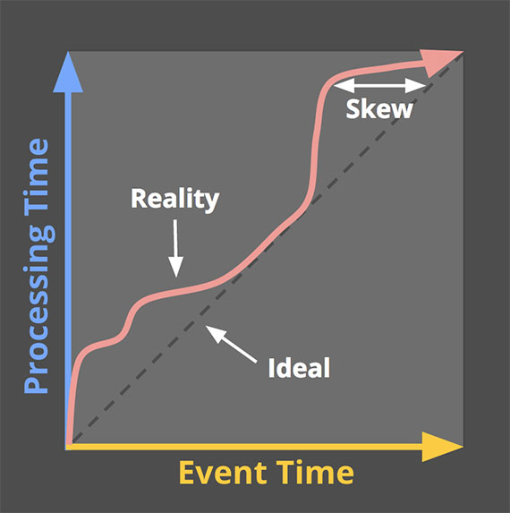
Event, Ingestion, and Processing Time
Event Time: the time when the event/data item was actually created.
  It is commonly provided by a timestamp field using the local clock of its source (e.g., a sensor).
Ingestion Time: the system time when the data item was received.
Processing Time: the system time when the data item is processed.
Reasons for Skew:
  Network overhead and failure
    Late and out-of-order arrival of data
  Resource congestion and contention at the stream processing system
    Delayed processing of data
Notes:
The X-axis represents event time completeness in the system, i.e. the time X in event time up to which all data with event times less than X have been observed. The Y-axis represents the progress of processing time, i.e. normal clock time as observed by the data processing system as it executes. Image: Tyler Akidau.
if we are interested in hourly, daily, or maybe yearly statistics. This can be the case, for example, if we are counting the clicks that a certain webpage received: what we are probably interested in is the number of clicks during some custom time periods of a certain granularity and not since our data processing application first started to operate.

Slide 55
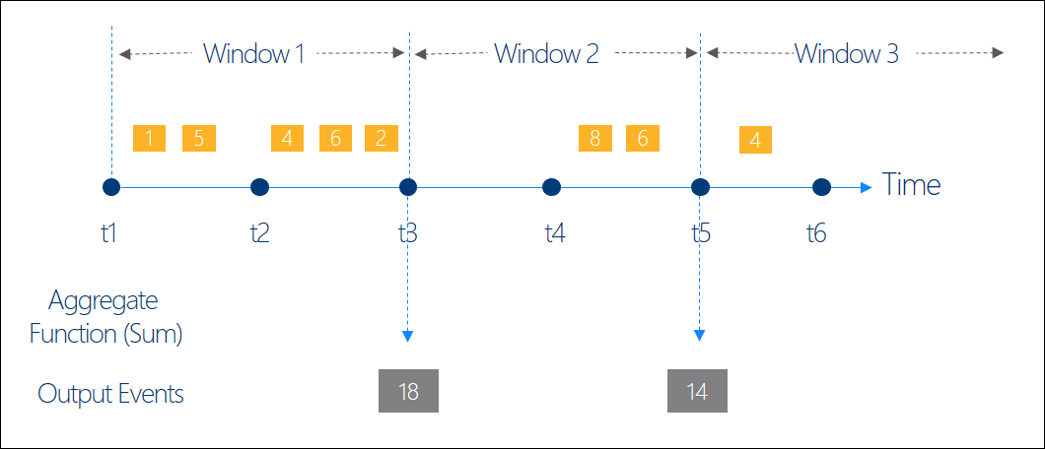
Windowing on Event Time
Windowing takes a data stream and partitions it along temporal boundaries into finite chunks for processing.
Key Window Types: Tumbling, Hopping, Sliding, Session, and Snapshot
Note:
Window 3 is the current Window.
Window 1 is the oldest window.
Count (Window 1) = 5
Count (Window 2) = 2
Sum (Window 1) = 18
Sum (Window 2) = 14
ref : https://docs.microsoft.com/en-us/azure/stream-analytics/stream-analytics-window-functions
Notes:
We use windowing techniques to logically group records of an infinite stream into finite sets, upon which we can perform aggregations or other custom operations.
The output event will have the time stamp of the end of the window and all window functions are defined with a fixed length.

Slide 56
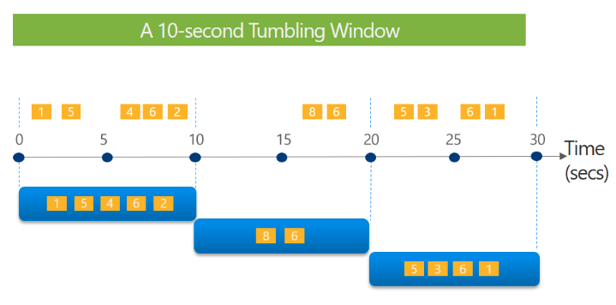
Tumbling/Fixed Window
Slice up time into segments with a fixed-size temporal length.
Non-overlapping fix Intervals
Can the same event be part of two different windows?
5,2,4
Tell me the count of tweets every 10 seconds
Note: Each yellow box is a tweet tuple.
ref : https://docs.microsoft.com/en-us/azure/stream-analytics/stream-analytics-window-functions

Slide 57
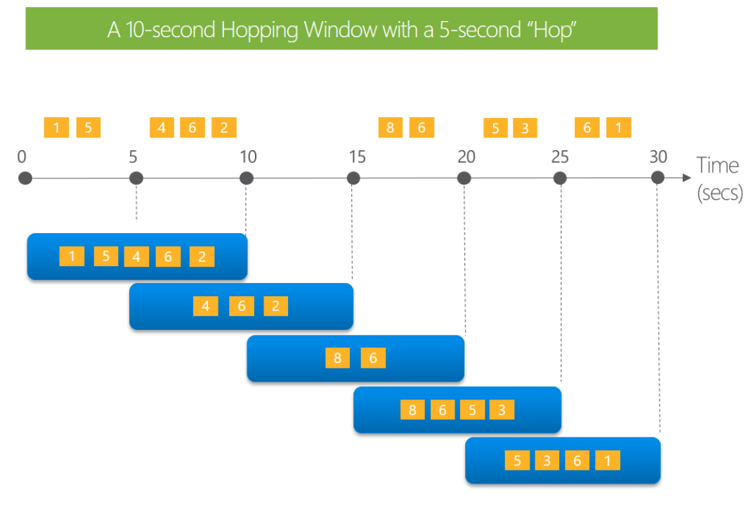
Hopping Window
1st jump at 15th seconds
Windows Hop forward in time by a fixed period.
Fixed Intervals with fixed overlapping.
Can the same event be part of two different windows?
What happens if the hop size is equal to the window size?
Every 5 seconds give me the count of tweets over the last 10 seconds

Slide 58
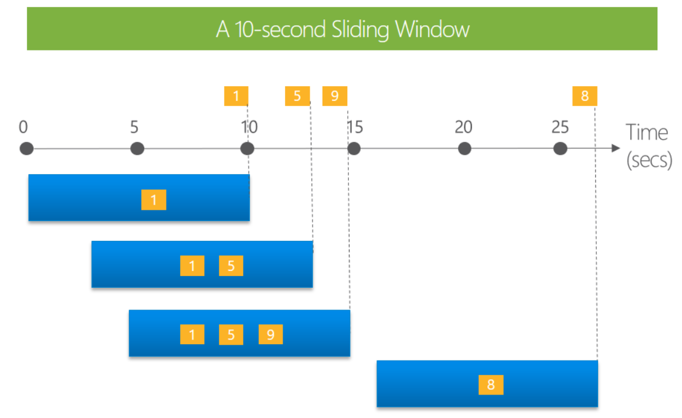
Sliding Window
Triggers query processing only when an event enters or exits the window (i.e., when the content of the window changes.)
Can the same event be part of two different windows?
Note: In this figure, all tweets on the diagram belong to the same topic
Give me the count of tweets for all topics that are tweeted more than 3 times in the last 10 seconds.
-,-,3,-
Notes:
Sliding windows, unlike Tumbling or Hopping windows, output events only for points in time when the content of the window actually changes. In other words, when an event enters or exits the window. So, every window has at least one event. Similar to Hopping windows, events can belong to more than one sliding window.

Slide 59
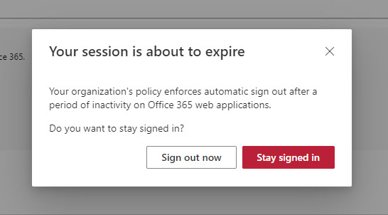
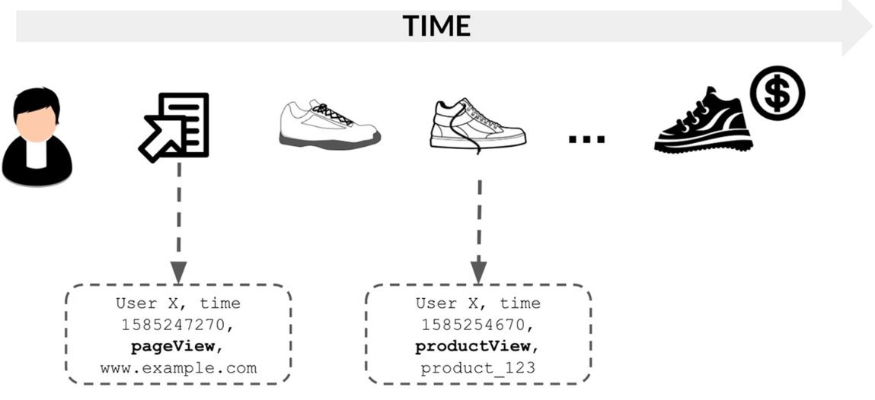
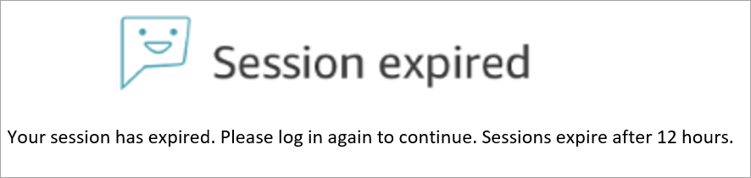
Session Window
What is a (web) session?
A (web) session is a series of contiguous actions by a visitor on an individual website within a given time frame. [1]
[1] https://hazelcast.com/glossary/web-session/
Notes:
https://office365itpros.com/2022/03/22/idle-session-timeout-policy/
https://docs.aws.amazon.com/connect/latest/adminguide/configure-saml.html
In the context of web development, a session refers to a way of maintaining state information about a user’s interactions with a website or web application.
"Session" is the term used to refer to a user's time browsing a web site. It's meant to represent the time between their first arrival at a page in the site until the time they stop using the site.

Slide 60
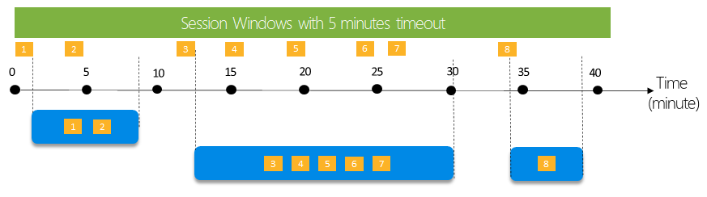
Session Window (Cont’d)
1st
2nd
3rd
2,5,1
Tell me the count of tweets that occur within 5 minutes to each other.
Sessions are composed of sequences of events terminated by a gap of inactivity greater than some timeout.
Session has a timeout and a maximum duration, e.g., 5 min and 10 min in the above example.
If events keep occurring within the specified timeout, the session window will keep extending until the maximum duration is reached.
The maximum duration checking intervals are set to be the same size as the specified max duration. e.g., at t = 0, 10, 20, 30, etc.
Notes:
A session window begins when the first event occurs. If another event occurs within the specified timeout from the last ingested event, then the window extends to include the new event. Otherwise if no events occur within the timeout, then the window is closed at the timeout.
If events keep occurring within the specified timeout, the session window will keep extending until maximum duration is reached. The maximum duration checking intervals are set to be the same size as the specified max duration. For example, if the max duration is 10, then the checks on if the window exceed maximum duration will happen at t = 0, 10, 20, 30, etc.

Slide 61
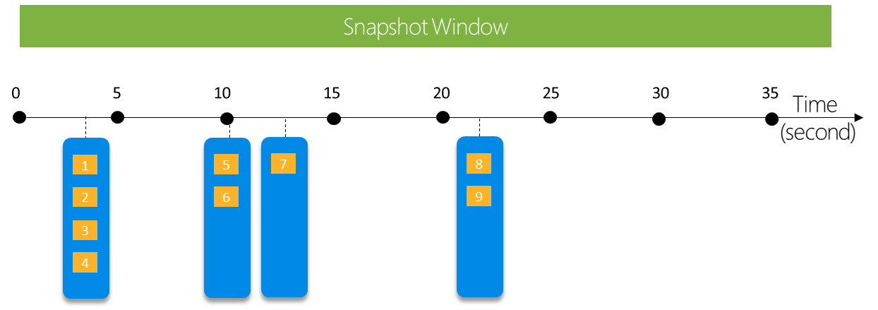
Snapshot Window
Group events that have the same timestamp
Give me the count of tweets with the same topic type that occur at exactly the same time.
4,2,1,2

Slide 62
Part 3:
Stream Processing Architectural Design Choices

Slide 63
General Architecture of a Stream Processing System
Stream ingestion/storage
Stream processing
Serving/Consumers
Stream sources/producers
streams
Output Sink 1
apps
streams
Query 1
streams
services
Output Sink m
Query n
Ad-Hoc Queries
Message Brokers
/Event Bus
Data Stream Processor
sensors
Can you give examples for output sinks?
Historical Data
Microservices
Notes:
The modern data streaming architecture includes the following key components:
Source - Your source of streaming data includes data sources like sensors, social media, IoT devices, log files generated by using your web and mobile applications, mobile devices that generates semi-structured and unstructured data as continuous streams at high velocity.
Stream storage - The stream storage layer is responsible for providing scalable and cost-effective components to store streaming data. The streaming data can be stored in the order it was received for a set duration of time, and can be replayed indefinitely during that time.
Stream ingestion - The stream ingestion layer is responsible for ingesting data into the stream storage layer. It provides the ability to collect data from tens of thousands of data sources and ingest in near real-time. .
Stream processing - The stream processing layer is responsible for transforming data into a consumable state through data validation, cleanup, normalization, transformation, and enrichment. The streaming records are read in the order they are produced, allowing for real-time analytics, building event driven applications, or streaming ETL.
Destination - The destination layer is like a purpose-built destination depending upon your use case. Your destination can be an event driven application, data lake, data warehouse, database, or an OpenSearch.

Slide 64
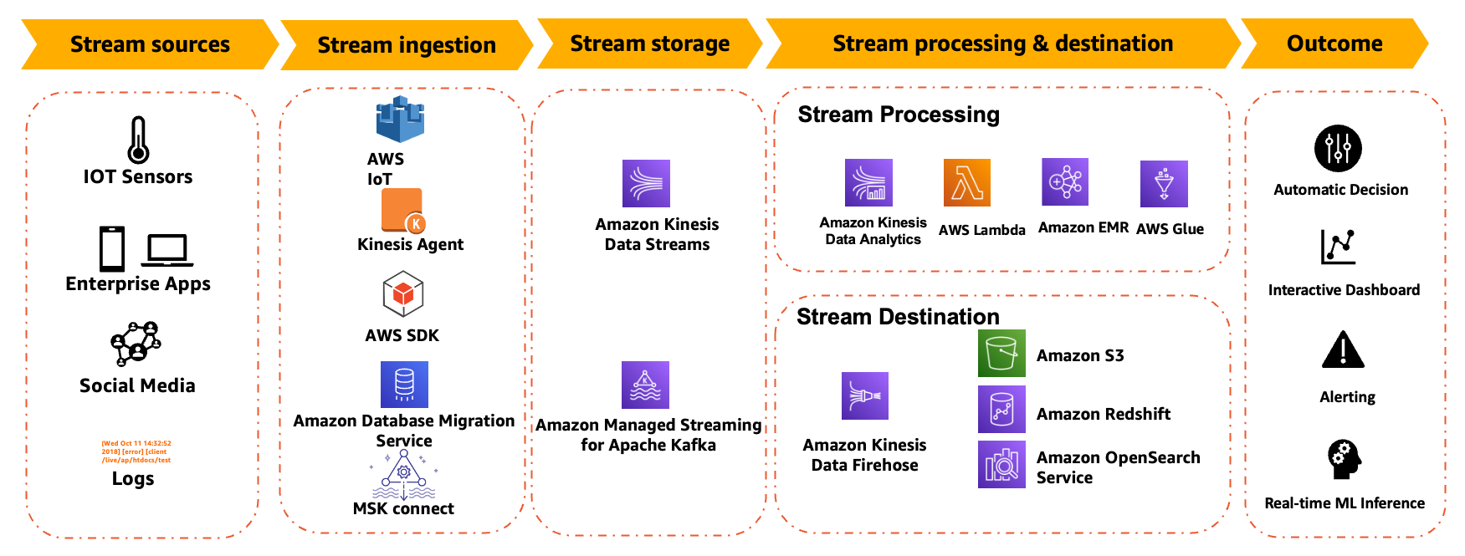
Stream Processing Architecture: AWS Example
ref : https://docs.aws.amazon.com/whitepapers/latest/build-modern-data-streaming-analytics-architectures/what-is-a-modern-streaming-data-architecture.html
Notes:
The streaming data lifecycle is segmented into the layers of modern data streaming architecture:
Stream sources - Streaming data sources can be application and click stream logs, mobile apps, existing transactional relational and NoSQL databases, IoT sensors and social media.
Stream ingestion - AWS IoT for ingesting IoT devices data into Kinesis Data Streams and Amazon MSK, Kinesis Agent for ingesting streaming data into Kinesis Data Streams and Amazon Data Firehose, AWS SDK for custom producers, AWS DMS for change data capture use cases and Amazon MSK connect for continuous ingest from files, change data capture from databases.
Stream storage - You can use Kinesis Data Streams, Amazon MSK and Apache Kafka on Amazon EC2 for your stream storage depending upon your use case. See Table 2 for additional details.
Stream processing - You can use Managed Service for Apache Flink for advanced streaming use cases with multiple destinations and stateful stream processing. AWS Lambda is good for event-based and stateless processing, and use cases like filtering, enrichments, and transformations. Use Amazon EMR to use your favorite open-source big data frameworks and use AWS Glue if you are already using AWS Glue or Apache Spark where you need to process data in batch, steaming, and event modes and you want to build your streaming jobs visually.
Downstream destinations - Your destination can be databases, data warehouses, purpose-built systems such as OpenSearch services, data lakes, event driven applications, and various third-party integrations.
Amazon EMR (Elastic MapReduce)

Slide 65
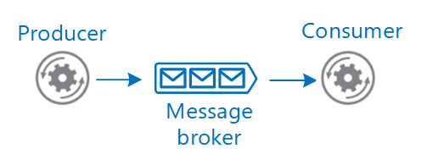
Stream Data Ingestion
Event Streaming Brokers or Message Brokers are generally used to collect, store, and deliver events/messages in a scalable and resilient manner.
Message brokers support two distinct messaging patterns/styles/models.
  Point-to-point messaging
  Publish/subscribe messaging
What are key advantages?
Loose coupling between stream sources and the stream processor
Improve the scalability and stability of the stream processor
https://learn.microsoft.com/en-us/azure/architecture/guide/technology-choices/messaging

Slide 66









Messaging Models: P2P
1. P2P - Point to Point:
1 queue per receiver (application).
One-to-one (1 sender, 1 receiver) or many-to-one messaging (many senders, 1 receiver).
Sending
application1
Receiving application
Sending
Application 2
Consumer
Producers
Ref http://www.indigoo.com/dox/wsmw/1_Middleware/MOM.pdf

Slide 67
























Messaging Models: P2P (Cont’d)
Queue types
FIFO queues (first in, first out):
All messages have the same priority level.
Messages are delivered in the order they are sent.
Sending application
3 2 1
3
2
1
Receiving application
Priority queues:
Messages are buffered in FIFO queues and ordered based on priority.
The ordering applies to the set of messages that are in the queue at a specific point in time (= the messages that are not yet received by an application).
Sending application
3
Prio 1
2
Prio 3
1
Prio 2
2
Prio 3
1
Prio 2
3
Prio 1
Receiving application
Messages
are re-ordered based on their priority

Slide 68

















Messaging Models: PubSub
2. Publish – Subscribe ("PubSub")
One-to-many or many-to-many distribution of messages (the same message may be received by multiple receivers).
Similar to a message board / forum:
Subscribe
Publish message
Sending application
Receive message
Receiving application
1
1
2
Topic
1
Receive message
Sending application
2
Receiving application
2
Publish
message

Slide 69
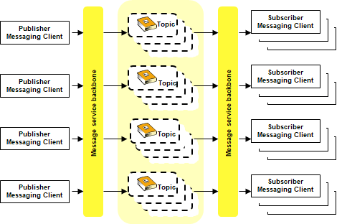
Topic Examples:
Prediction Input – for ingesting input data for a prediction service
Prediction output – for storing/sending the prediction results
Model X Performance – for ingesting model performance metrics (monitored)
Order – for ingesting order request messages (e-commerce)
Room Temperature – for ingesting room temperature measurements from sensors in a building
Messaging Models: PubSub (Cont’d)
Notes:
A topic is the subject of the information that is published in a publish/subscribe message. The topic can be seen as a tag of a certain type of data.

Slide 70
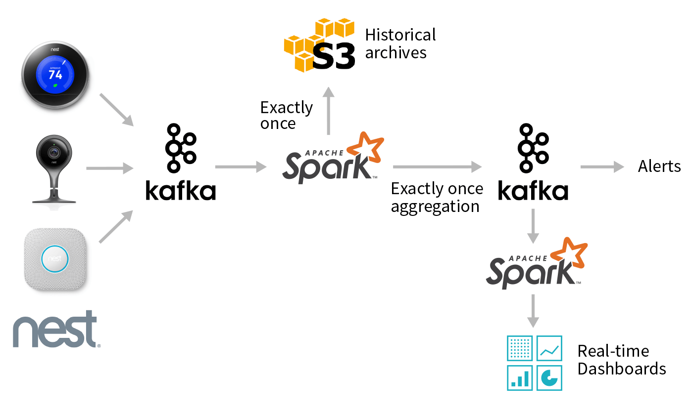
Example: Nest Devices Logs Processing
Stream
  counts the number of camera person sightings in each zip code for each hour.
  save the raw camera records in persistent storage for later use.
Batch
  generate a report showing zip codes with a significant number of sightings.
Topic: nest-camera-stats
Stream
Topic : nest-logs
Batch
https://www.databricks.com/blog/2017/04/26/processing-data-in-apache-kafka-with-structured-streaming-in-apache-spark-2-2.html
Notes:
At a high-level, the desired workflow looks like the graph above. Given a stream of updates from Nest cameras, we want to use Spark to perform several different tasks:
Create an efficient, queryable historical archive of all events using a columnar format like Parquet.
Perform low-latency event-time aggregation and push the results back to Kafka for other consumers.
Perform batch reporting on the data stored in a compacted topic in Kafka.

Slide 71
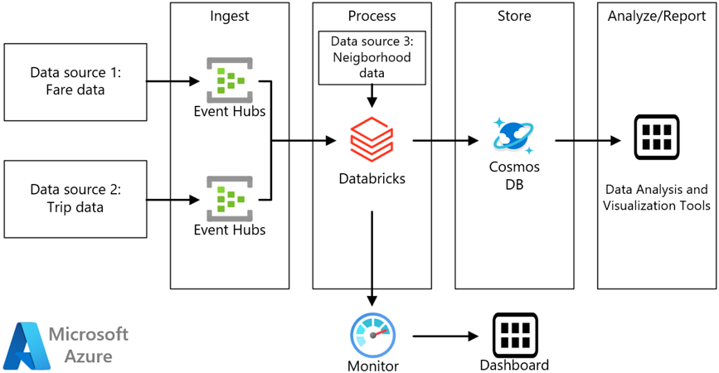
Stream Processing Example (Ridership Trends) : Stream Processing with Azure Databricks
Stream query: the average fare amount for each neighborhood for a given time interval.
Ref: https://learn.microsoft.com/en-us/azure/architecture/reference-architectures/data/stream-processing-databricks
Notes:
Cosmos DB is a fully managed NoSQL, relational, and vector database
A taxi company collects data about each taxi trip. For this scenario, we assume there are two separate devices sending data. The taxi has a meter that sends information about each ride — the duration, distance, and pickup and drop-off locations. A separate device accepts payments from customers and sends data about fares. To spot ridership trends, the taxi company wants to calculate the average tip per mile driven, in real time, for each neighborhood.

Slide 72
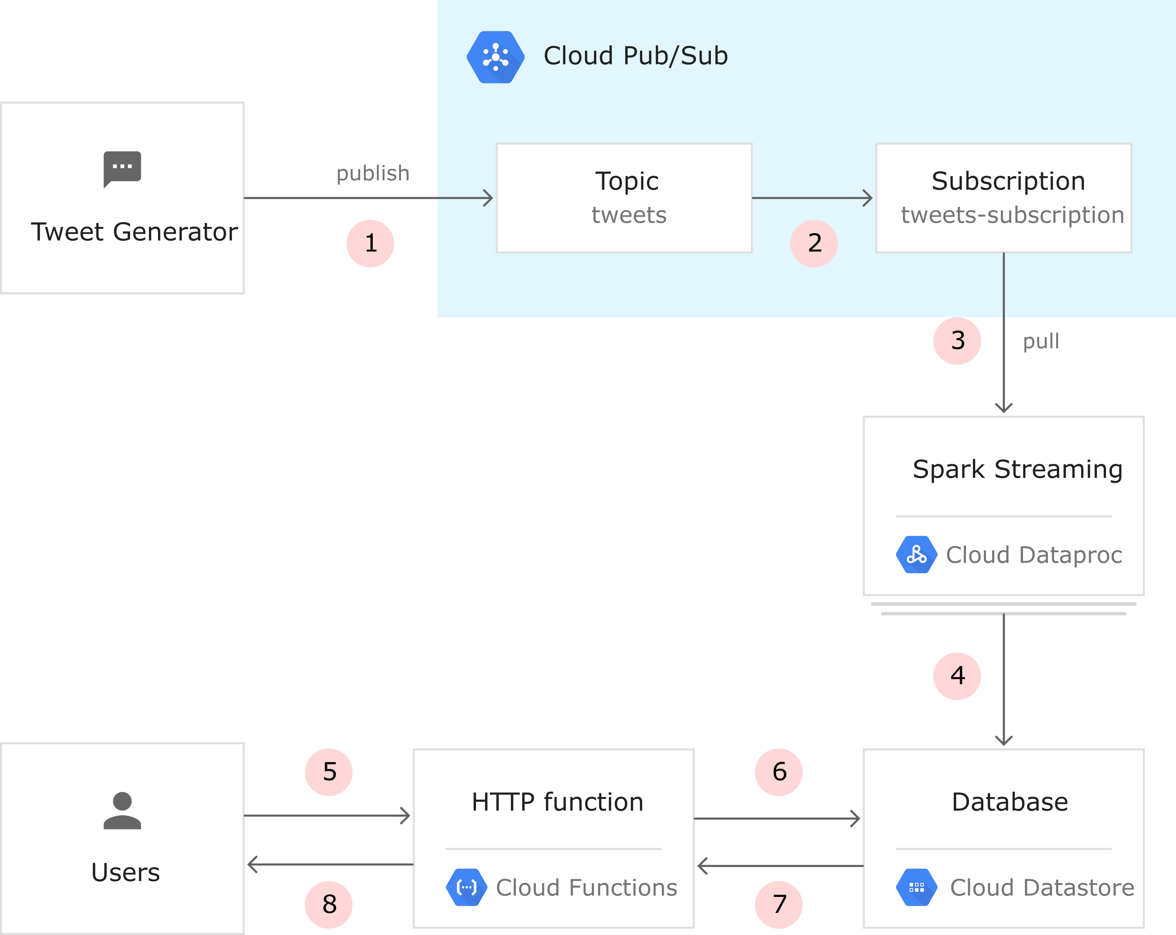
Stream Processing Example : GCP with Spark
Stream query: identify trending hashtags in near real time
Ref: https://cloud.google.com/architecture/using-apache-spark-dstreams-with-dataproc-and-pubsub

Slide 73
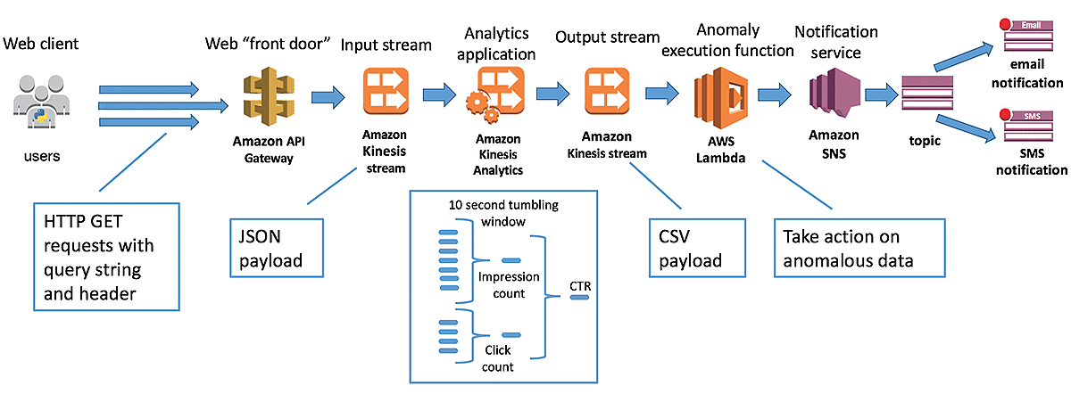
Real-time Clickstream Anomaly Detection : AWS
Anomalous low-end CTR that could be a result of a bad image, etc.
Click Through Rate (CTR) = Clicks / Impressions * 100.
An impression is when an ad is displayed in a browser, and a clickthrough represents a user clicking on that ad.
https://aws.amazon.com/blogs/big-data/real-time-clickstream-anomaly-detection-with-amazon-kinesis-analytics/
Notes:
One use case where it’s valuable to have immediate insights is analyzing clickstream data. In the world of digital advertising, an impression is when an ad is displayed in a browser and a clickthrough represents a user clicking on that ad. A clickthrough rate (CTR) is one way to monitor the ad’s effectiveness. CTR is calculated in the form of: CTR = Clicks / Impressions * 100. Digital marketers are interested in monitoring CTR to know when particular ads perform better than normal, giving them a chance to optimize placements within the ad campaign. They may also be interested in anomalous low-end CTR that could be a result of a bad image or bidding model.

Slide 74
Stream Data Processing Models
There are two main models for processing stream data (by a stream processing engine)
  Continuous stream processing model (or record-at-a-time processing model or stream-dataflow model)
  Micro-batch processing model

Slide 75
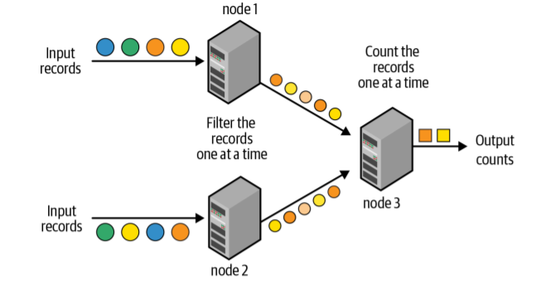

Continuous Stream Processing Model
The programming model is dataflow based (a DAG of nodes). Each node in the graph is a processing entity and the links between nodes (dependencies) represent data streams of records.
Each node continuously receives one record at a time, processes it (i.e., apply operations such as filter, map, window, aggregate, and join), and then forwards the generated record(s) to the next node in the graph.
Note: Here, a node is a node in the pipeline/DAG (not a VM or Physical Machine)
Ref: Learning Spark: Lightning-Fast Data Analytics

Slide 76
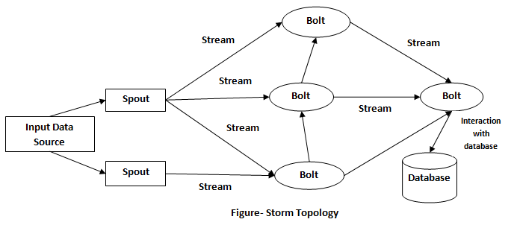
Continuous Stream Processing Model : Apache Storm
Spout: creates one or more data streams for use by bolts.
Bolt: accepts one or more data streams from spouts or from other bolts and emits zero or more streams for use by other bolts. A bolt can write data to external services or storage.
Topology: A directed acyclic graph of spouts and bolts.
https://storm.apache.org/releases/2.0.0/Tutorial.html
Notes:
https://storm.apache.org/releases/2.0.0/Tutorial.html

Slide 77
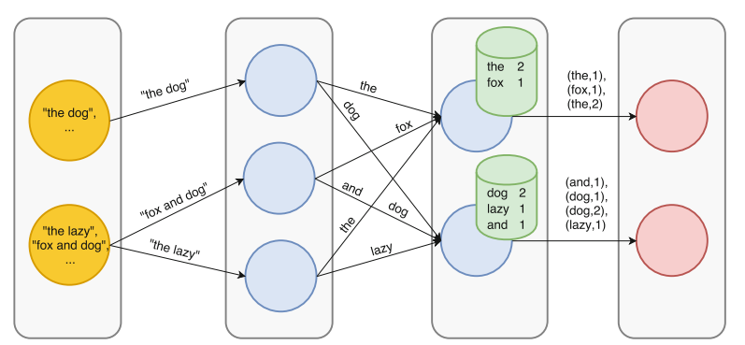
Continuous Stream Processing Model: Word Counting
Shuffling
A
B
Input
Split (Stateless)
Count (Stateful)
Output
Large-Scale Data Stream Processing Systems, Carbone et al.

Slide 78
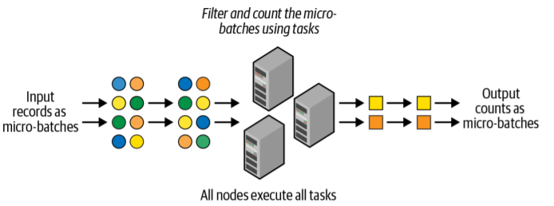
Micro-Batch Processing Model
Model a “stream” computation as a sequence of transformations on bounded sets by discretizing a distributed data stream into batches and then scheduling the processing of these batches sequentially in a cluster of worker nodes.
A continuous series of small, map/reduce-style batch processing jobs on small chunks (discretized batches) of the stream data.
Ref: Learning Spark: Lightning-Fast Data Analytics
Notes:
A Performance Comparison of Open-Source Stream Processing Platforms
https://ieeexplore.ieee.org/abstract/document/7841533
Though it is not true real-time processing, micro-batch processing initially sufficed to support some “real-time” use cases in which data does not need to be up-to-the-moment accurate. For example, you may have corporate dashboards that refresh every 15 minutes or hourly. Or you may collect server logs in small regular intervals for historical record-keeping rather than for true real-time use cases such as intrusion detection.

Slide 79
Continuous vs Micro-Batch
Latency
  Very low (almost real-time)
Programing Flexibility
  Event-based granularity for any custom processing task
Processing guarantee upon Failure
  Difficult to support exactly once processing guarantee
Latency
  An order of several seconds at a minimum
Programing Flexibility
  Constrained but sufficient
Processing guarantee upon Failure
  Easy to support exactly once processing guarantee
Continuous Stream Processing Model
Micro-Batch Processing Model
Notes:
https://jaksa.wordpress.com/2009/05/01/active-and-passive-replication-in-distributed-systems/

Slide 80
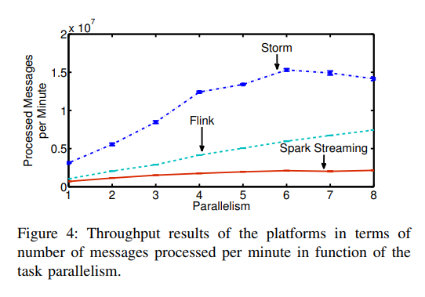
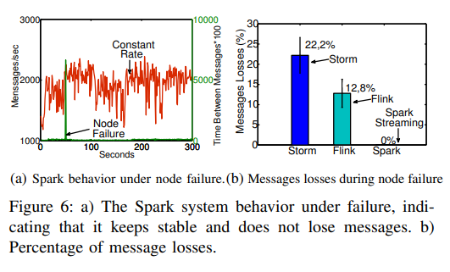
Continuous vs Micro-Batch (Cont’d)
Compute Node
M. A. Lopez, A. G. P. Lobato and O. C. M. B. Duarte, "A Performance Comparison of Open-Source Stream Processing Platforms," 2016 IEEE Global Communications Conference (GLOBECOM), 2016, pp. 1-6, doi: 10.1109/GLOCOM.2016.7841533.

Slide 81
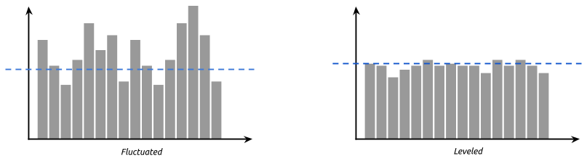
Stream Processing Concerns: Handling Intermittent Spikes
There is always a skew between the ingestion and processing rates.
Actual Data Input Rate
Desired Data Input Rate
#1 Back-Pressure
Backpressure is when the progress of turning an input into an output is resisted in some way.
Options:
  Put pressure back on (or ask from) the producers to regulate their traffic.
  Halt data sources (pause or cancel the stream) so that the data injection stops until backpressure is off.
#2 Load Shedding
Process of dropping excess load from the system when the demand on resources is above the system capacity.
A common approach is to use message queues:
  have a limit on the queues and drop messages that are added over the limit.
#3 Auto Scaling
Scale up when traffic increases and scale them down when traffic decreases (horizonal or/and vertical).
See https://research.cs.queensu.ca/home/cordy/Papers/AZC_CASCON16_AutoScaling.pdf
Rsocket - https://rsocket.io/
Notes:
Backpressure occurs when a receiving node (e.g., server) is unable to process incoming data at the rate it is being sent by the sending node.
The back-pressure could be defined as the pressure within a system caused by fluid friction or an induced resistance to flow through the system. In reactive streams, backpressure roughly means that the consumer gives the producer information about the number of messages it can send. Per specification, the client cannot send more messages than the allowed number.
Proactive auto-scaling techniques can be used predict future bottlenecks and make scalability decisions in advance of the actual bottleneck
Reactive auto-scaling techniques collect metrics about the utilization of a monitored system, then use these metrics to decide whether to grow or shrink the required resources. Such reactive techniques can lead to losing a large amount of data when a sudden bottleneck occurs before the scaling decision can be made
https://stackoverflow.com/questions/52244808/backpressure-mechanism-in-spring-web-flux

Slide 82
Stream Processing Concerns: Processing Guarantees Upon Failure
#1 At Most Once
Ensure data is never counted twice.
Might cause input data loss on failures or when the system is overloaded.
#2 At Least Once
No input data loss
Replay a stream from a checkpoint on failures
Might create an incorrect state because some data records can be processed multiple times.
#3 Exactly Once
No loss of input data and also ensure that each input record led to exactly one state update in the output.
Difficult to achieve for the continuous data processing model
Notes:
Atomicity, Consistency, Isolation, and Durability.

Slide 83
Recap
We discussed the concept of stream data processing
We discussed window-based stream processing
We discussed the general architecture and some design decisions for stream data processing

Slide 84
References
Carbone, P. et al. (2017). Large-Scale Data Stream Processing Systems. In: Zomaya, A., Sakr, S. (eds) Handbook of Big Data Technologies. Springer, Cham. https://doi.org/10.1007/978-3-319-49340-4_7
https://www.oreilly.com/radar/the-world-beyond-batch-streaming-101/
https://www.oreilly.com/radar/the-world-beyond-batch-streaming-102/
Lecture 36 — Mining Data Streams | Mining of Massive Datasets | Stanford University
  https://www.youtube.com/watch?v=SRTSVxUnsNI&list=PLLssT5z_DsK9JDLcT8T62VtzwyW9LNepV&index=36

